Slide 1
Application:
The Costs of Taxation
© 2015 Cengage Learning. All Rights Reserved. May not be copied, scanned, or duplicated, in whole or in part, except for use as permitted in a license distributed with a certain product or service or otherwise on a password-protected website for classroom use.

Slide 2
Deadweight Loss of Taxation
Tax on a good levied on buyers
  Demand curve shifts leftward
    By the size of tax
Tax on a good levied on sellers
  Supply curve shifts leftward
    By the size of tax
© 2015 Cengage Learning. All Rights Reserved. May not be copied, scanned, or duplicated, in whole or in part, except for use as permitted in a license distributed with a certain product or service or otherwise on a password-protected website for classroom use.

Slide 3
Deadweight Loss of Taxation
Tax on a good levied on buyers or on sellers
  Same outcome: a price wedge
  Price paid by buyers rises
  Price received by sellers falls
  Lower quantity sold
© 2015 Cengage Learning. All Rights Reserved. May not be copied, scanned, or duplicated, in whole or in part, except for use as permitted in a license distributed with a certain product or service or otherwise on a password-protected website for classroom use.

Slide 4
Deadweight Loss of Taxation
Tax burden
  Distributed between producers and consumers
  Determined by elasticities of supply and demand
Market for the good
  Smaller
© 2015 Cengage Learning. All Rights Reserved. May not be copied, scanned, or duplicated, in whole or in part, except for use as permitted in a license distributed with a certain product or service or otherwise on a password-protected website for classroom use.

Slide 5



Figure 1
The Effects of a Tax
Price
Supply
Size of tax
Demand
0
Quantity
with tax
Quantity
without tax
Quantity
A tax on a good places a wedge between the price that buyers pay and the price that sellers receive. The quantity of the good sold falls.
© 2015 Cengage Learning. All Rights Reserved. May not be copied, scanned, or duplicated, in whole or in part, except for use as permitted in a license distributed with a certain product or service or otherwise on a password-protected website for classroom use.

Slide 6

Deadweight Loss of Taxation
Economic welfare
  Buyers: consumer surplus
  Sellers: producer surplus
  Government: total tax revenue
    Tax times quantity sold
    Public benefit from the tax
“You know, the idea of taxation with representation doesn’t appeal to me very much, either.”
© 2015 Cengage Learning. All Rights Reserved. May not be copied, scanned, or duplicated, in whole or in part, except for use as permitted in a license distributed with a certain product or service or otherwise on a password-protected website for classroom use.

Slide 7
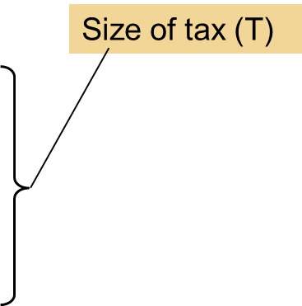

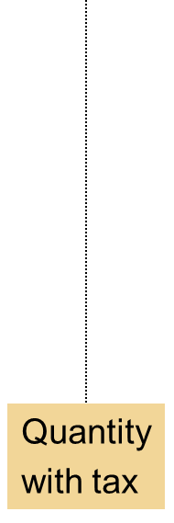
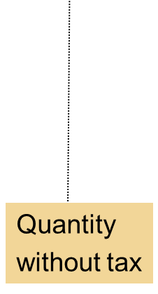

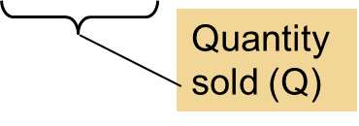
Figure 2
Tax Revenue
Price
Supply
Tax
revenue
T ˣ Q
Demand
0
Quantity
The tax revenue that the government collects equals T × Q, the size of the tax T times the quantity sold Q. Thus, tax revenue equals the area of the rectangle between the supply and demand curves.
© 2015 Cengage Learning. All Rights Reserved. May not be copied, scanned, or duplicated, in whole or in part, except for use as permitted in a license distributed with a certain product or service or otherwise on a password-protected website for classroom use.

Slide 8
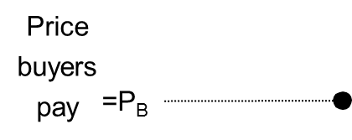

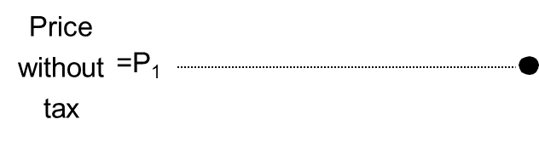

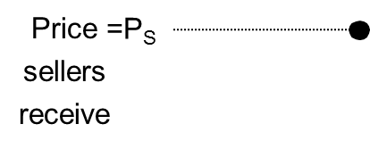
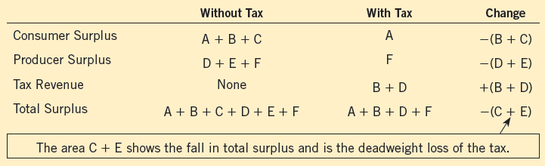
Figure 3
How a Tax Affects Welfare
Price
A tax on a good reduces consumer surplus (by the area B + C) and producer surplus (by the area D + E). Because the fall in producer and consumer surplus exceeds tax revenue (area B + D), the tax is said to impose a deadweight loss (area C + E).
A
Supply
B
D
F
Demand
0
Q₂
Q₁
Quantity
© 2015 Cengage Learning. All Rights Reserved. May not be copied, scanned, or duplicated, in whole or in part, except for use as permitted in a license distributed with a certain product or service or otherwise on a password-protected website for classroom use.

Slide 9
Deadweight Loss of Taxation
Welfare without a tax
  Consumer surplus, areas A, B, and C
  Producer surplus, areas D, E, and F
  Total tax revenue = 0
Welfare with tax
  Smaller consumer surplus, area A
  Smaller producer surplus, area F
  Total tax revenue, areas B and D
  Smaller overall welfare
© 2015 Cengage Learning. All Rights Reserved. May not be copied, scanned, or duplicated, in whole or in part, except for use as permitted in a license distributed with a certain product or service or otherwise on a password-protected website for classroom use.

Slide 10
Deadweight Loss of Taxation
Losses of surplus to buyers and sellers, from a tax
  Exceed the revenue raised by the government
Deadweight loss
  Fall in total surplus that results from a market distortion, such as a tax
Taxes distort incentives
  Markets allocate resources inefficiently
© 2015 Cengage Learning. All Rights Reserved. May not be copied, scanned, or duplicated, in whole or in part, except for use as permitted in a license distributed with a certain product or service or otherwise on a password-protected website for classroom use.

Slide 11
Deadweight Loss of Taxation
Deadweight losses and gains from trade
  Taxes cause deadweight losses
    Prevent buyers and sellers from realizing some of the gains from trade
  The gains from trade
    Difference between buyers’ value and sellers’ cost are less than the tax
    Once the tax is imposed
      Trades are not made
      Deadweight loss
© 2015 Cengage Learning. All Rights Reserved. May not be copied, scanned, or duplicated, in whole or in part, except for use as permitted in a license distributed with a certain product or service or otherwise on a password-protected website for classroom use.

Slide 12
Figure 4
The Source of a Deadweight Loss
Price
Lost gains
from trade
Supply
P_{B}
Size of tax
Price without tax
P_{S}
Cost to
sellers
Demand
Value to
buyers
0
Q₂
Q₁
Quantity
Reduction in quantity due to the tax
When the government imposes a tax on a good, the quantity sold falls from Q₁ to Q₂. At every quantity between Q₁ and Q₂, the potential gains from trade among buyers and sellers are not realized. These lost gains from trade create the deadweight loss.
© 2015 Cengage Learning. All Rights Reserved. May not be copied, scanned, or duplicated, in whole or in part, except for use as permitted in a license distributed with a certain product or service or otherwise on a password-protected website for classroom use.

Slide 13
Determinants of Deadweight Loss
Price elasticities of supply and demand
  More elastic supply curve
    Larger deadweight loss
  More elastic demand curve
    Larger deadweight loss
The greater the elasticities of supply and demand
  The greater the deadweight loss of a tax
© 2015 Cengage Learning. All Rights Reserved. May not be copied, scanned, or duplicated, in whole or in part, except for use as permitted in a license distributed with a certain product or service or otherwise on a password-protected website for classroom use.

Slide 14
Figure 5
Tax Distortions and Elasticities (a, b)
(a) Inelastic Supply
(b) Elastic Supply
When supply is relatively inelastic, the deadweight loss of a tax is small
Price
Price
When supply is relatively elastic, the deadweight loss of a tax is large
Supply
Supply
Size
of tax
Size
of tax
Demand
Demand
0
Quantity
0
Quantity
In panels (a) and (b), the demand curve and the size of the tax are the same, but the price elasticity of supply is different. Notice that the more elastic the supply curve, the larger the deadweight loss of the tax.
© 2015 Cengage Learning. All Rights Reserved. May not be copied, scanned, or duplicated, in whole or in part, except for use as permitted in a license distributed with a certain product or service or otherwise on a password-protected website for classroom use.

Slide 15
Figure 5
Tax Distortions and Elasticities (c, d)
(c) Inelastic Demand
(d) Elastic Demand
When demand is relatively inelastic, the deadweight loss of a tax is small
When demand is relatively elastic, the deadweight loss of a tax is large
Price
Price
Supply
Supply
Size
of tax
Size
of tax
Demand
Demand
0
Quantity
0
Quantity
In panels (c) and (d), the supply curve and the size of the tax are the same, but the price elasticity of demand is different. Notice that the more elastic the demand curve, the larger the deadweight loss of the tax.
© 2015 Cengage Learning. All Rights Reserved. May not be copied, scanned, or duplicated, in whole or in part, except for use as permitted in a license distributed with a certain product or service or otherwise on a password-protected website for classroom use.

Slide 16
The deadweight loss debate
How big should the government be?
  The larger the deadweight loss of taxation
    The larger the cost of any government program
  If taxes impose large deadweight losses
    These losses are a strong argument for a leaner government that does less and taxes less
  If taxes impose small deadweight losses
    Government programs are less costly
© 2015 Cengage Learning. All Rights Reserved. May not be copied, scanned, or duplicated, in whole or in part, except for use as permitted in a license distributed with a certain product or service or otherwise on a password-protected website for classroom use.

Slide 17
The deadweight loss debate
How big are the deadweight losses of taxation?
  Economists disagree
  Tax on labor (the labor tax)
    Social Security tax, Medicare tax, federal income tax
    Places a wedge between the wage that firms pay and the wage that workers receive
    Marginal tax rate on labor income is 40%
      The tax rate on the last dollar of earnings
© 2015 Cengage Learning. All Rights Reserved. May not be copied, scanned, or duplicated, in whole or in part, except for use as permitted in a license distributed with a certain product or service or otherwise on a password-protected website for classroom use.

Slide 18
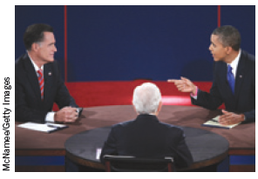
The deadweight loss debate
40% labor tax - Small or large deadweight loss?
Some believe labor supply is fairly inelastic
  Almost vertical
    Most people would work full-time regardless of wage
  Tax on labor: small deadweight loss
“What’s your position on the elasticity of labor supply?”
© 2015 Cengage Learning. All Rights Reserved. May not be copied, scanned, or duplicated, in whole or in part, except for use as permitted in a license distributed with a certain product or service or otherwise on a password-protected website for classroom use.

Slide 19
The deadweight loss debate
Others: labor supply is more elastic
  Tax on labor: greater deadweight loss
    Many workers can adjust the number of hours they work (overtime)
    Some families have second earners
      Some discretion over whether to do unpaid work at home or paid work in the marketplace
    Many of the elderly can choose when to retire
    Some people consider engaging in illegal economic activity
© 2015 Cengage Learning. All Rights Reserved. May not be copied, scanned, or duplicated, in whole or in part, except for use as permitted in a license distributed with a certain product or service or otherwise on a password-protected website for classroom use.

Slide 20
Deadweight Loss & Tax Revenue
As the tax increases
  Deadweight loss increases
    Even more rapidly than the size of the tax
  Tax revenue
    Increases initially
    Then decreases
      Higher tax: drastically reduces the size of the market
© 2015 Cengage Learning. All Rights Reserved. May not be copied, scanned, or duplicated, in whole or in part, except for use as permitted in a license distributed with a certain product or service or otherwise on a password-protected website for classroom use.

Slide 21
Figure 6
How Deadweight Loss and Tax Revenue Vary with the Size of a Tax (a, b, c)
(a) Small tax
(b) Medium tax
(c) Large tax
Price
Price
Price
Deadweight loss
Deadweight loss
Deadweight loss
Supply
Supply
P_{B}
P_{B}
Supply
P_{B}
Tax
revenue
Tax
revenue
P_{S}
Tax revenue
Demand
P_{S}
Demand
Demand
P_{S}
0
Q₂
Q₁
0
Q₂
Q₁
0
Q₂
Q₁
Quantity
Quantity
Quantity
The deadweight loss is the reduction in total surplus due to the tax. Tax revenue is the amount of the tax times the amount of the good sold. In panel (a), a small tax has a small deadweight loss and raises a small amount of revenue. In panel (b), a somewhat larger tax has a larger deadweight loss and raises a larger amount of revenue. In panel (c), a very large tax has a very large deadweight loss, but because it has reduced the size of the market so much, the tax raises only a small amount of revenue.
© 2015 Cengage Learning. All Rights Reserved. May not be copied, scanned, or duplicated, in whole or in part, except for use as permitted in a license distributed with a certain product or service or otherwise on a password-protected website for classroom use.

Slide 22
Figure 6
How Deadweight Loss and Tax Revenue Vary with the Size of a Tax (d, e)
(d) From panel (a) to panel (c),
deadweight loss continually increases
(e) From panel (a) to panel (c), tax
revenue first increases, then decreases
Deadweight loss
Tax Revenue
Laffer curve
0
Tax size
0
Tax size
Panels (d) and (e) summarize these conclusions. Panel (d) shows that as the size of a tax grows larger, the deadweight loss grows larger. Panel (e) shows that tax revenue first rises and then falls. This relationship is sometimes called the Laffer curve.
© 2015 Cengage Learning. All Rights Reserved. May not be copied, scanned, or duplicated, in whole or in part, except for use as permitted in a license distributed with a certain product or service or otherwise on a password-protected website for classroom use.

Slide 23
The Laffer curve and supply-side economics
1974, economist Arthur Laffer
  Laffer curve
  Supply-side economics
  Tax rates were so high, that reducing them would actually raise tax revenue
Ronald Reagan’s experience in film industry
  High tax rates caused less work
  Low tax rates caused more work
© 2015 Cengage Learning. All Rights Reserved. May not be copied, scanned, or duplicated, in whole or in part, except for use as permitted in a license distributed with a certain product or service or otherwise on a password-protected website for classroom use.

Slide 24
The Laffer curve and supply-side economics
Ronald Reagan ran for president in 1980
  Platform: cutting taxes
  Argument
    Taxes were so high that they were discouraging hard work
    Lower taxes would give people the proper incentive to work
  Raise economic well-being
  Perhaps increase tax revenue
© 2015 Cengage Learning. All Rights Reserved. May not be copied, scanned, or duplicated, in whole or in part, except for use as permitted in a license distributed with a certain product or service or otherwise on a password-protected website for classroom use.

Slide 25
The Laffer curve and supply-side economics
Economists
  Continue to debate Laffer’s argument
  No consensus about the size of the relevant elasticities
General lesson:
  Change in tax revenue from a tax change depends on how the tax change affects people’s behavior
© 2015 Cengage Learning. All Rights Reserved. May not be copied, scanned, or duplicated, in whole or in part, except for use as permitted in a license distributed with a certain product or service or otherwise on a password-protected website for classroom use.

